Slide 1

Model Selection
Kenichiro McAlinn

Slide 2
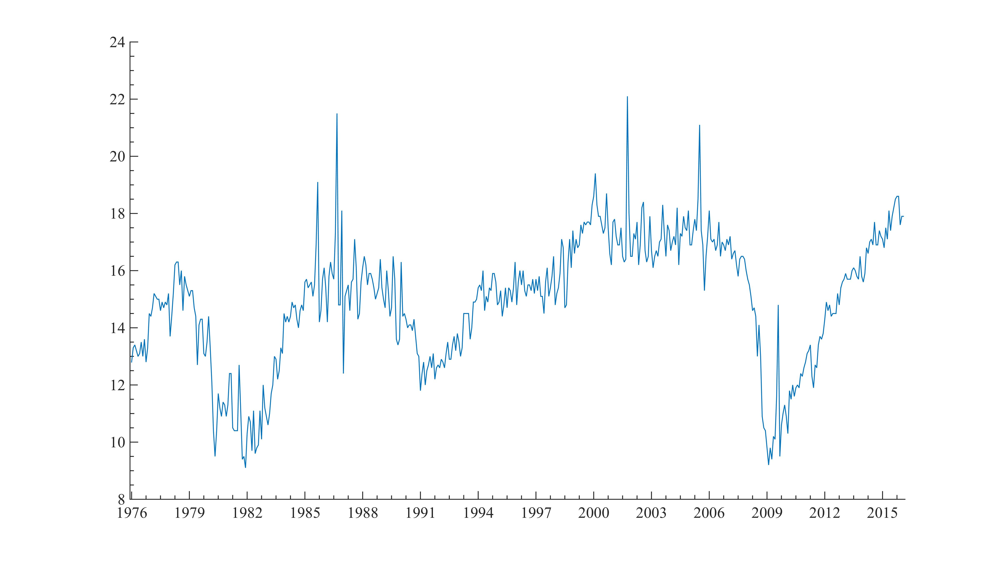
Model Selection
Task: Build a model to forecast car sales
What kind of model works best?
What kind of variables should you use?
What frequency of data should you use?
How far back do you need to use?
How do you choose the best model?

Slide 3
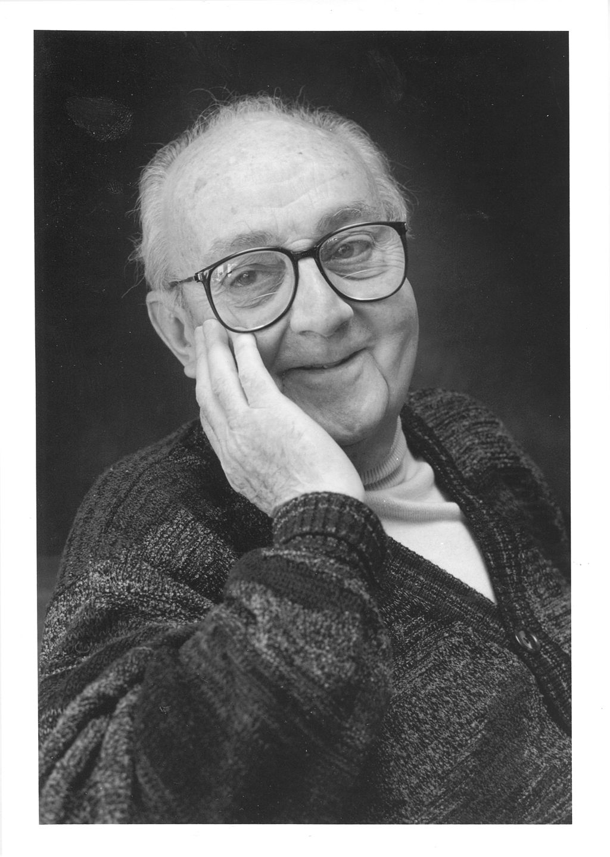
Model Selection
Model selection isn’t easy!
There is no true model
"Essentially, all models are wrong, but some are useful.”
- Box, George E. P.

Slide 4




Slide 5
Model Selection
Model selection isn’t easy!
There is no true model
"Essentially, all models are wrong, but some are useful.”
- Box, George E. P.
You can never really test a model
… until you actually use it
You don’t know how well your model predicts,
until you actually predict something in the future

Slide 6
Model Selection
What’s a characteristic of a good model?
Fit the data well?
Fits your narrative well?
Predicts well?
Improves your decision making process!

Slide 7
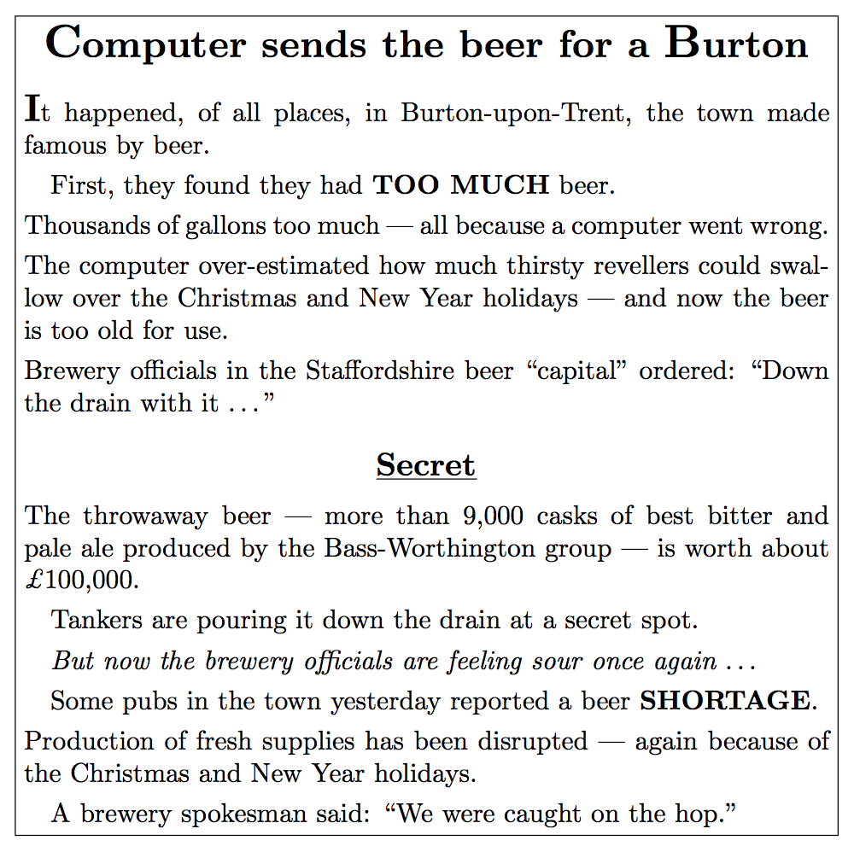
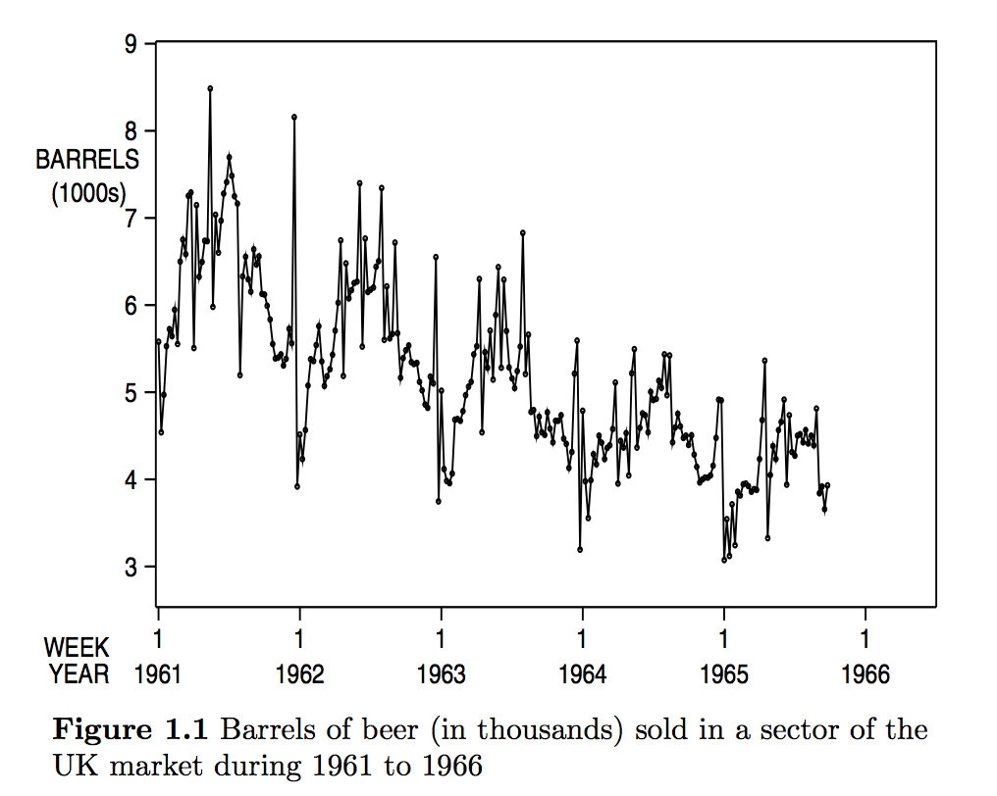
Model Selection

Slide 8
Model Selection
Learning
Testing
In-sample
Out-of-sample

Slide 9
Model Selection
No testing
All in-sample testing
Cross validation
Test your model by holding out data
(quasi-out-of-sample)

Slide 10
Model Selection
Comparing models
How do you compare your models?
What criteria do you use for in-sample data?
What criteria do you use for out-of-sample data?

Slide 11
Model Selection
Comparing models
How do you compare your models
using out-of-sample data?
Whether it works in making decisions

Slide 12
Model Selection
Comparing models
How do you compare your models
using in-sample data?
Can we use the same criteria
in out-of-sample data?
Not really…
Over-fitting
Trade-off between simple and complex models

Slide 13
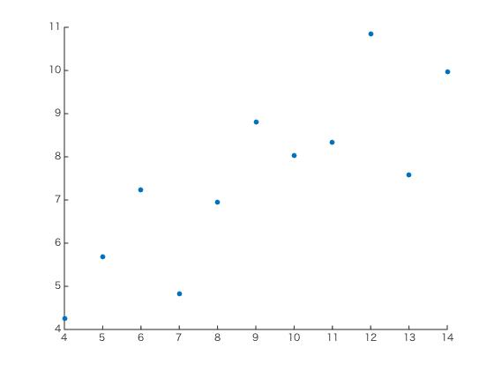
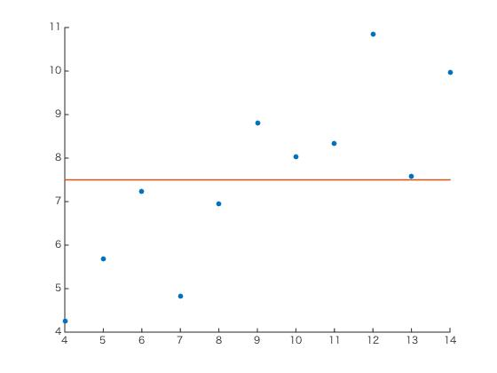
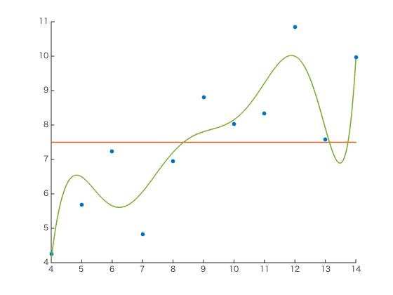

Slide 14
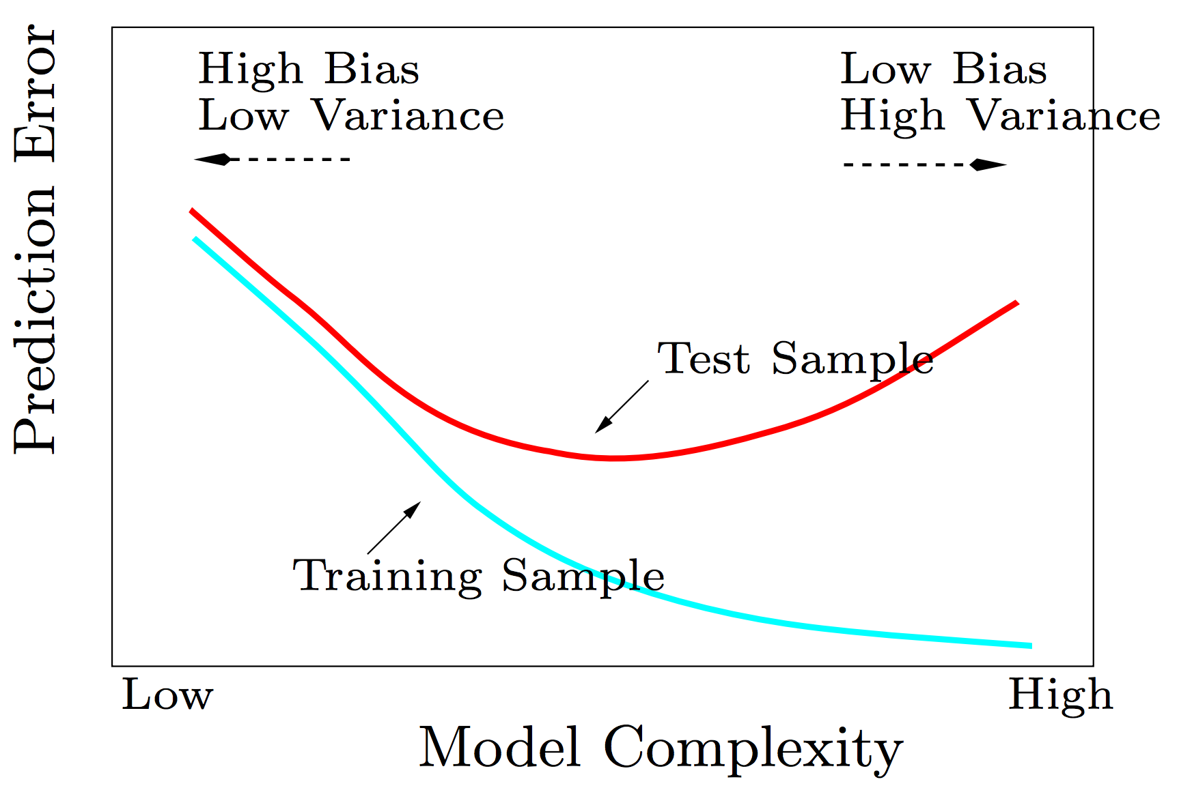

Slide 15
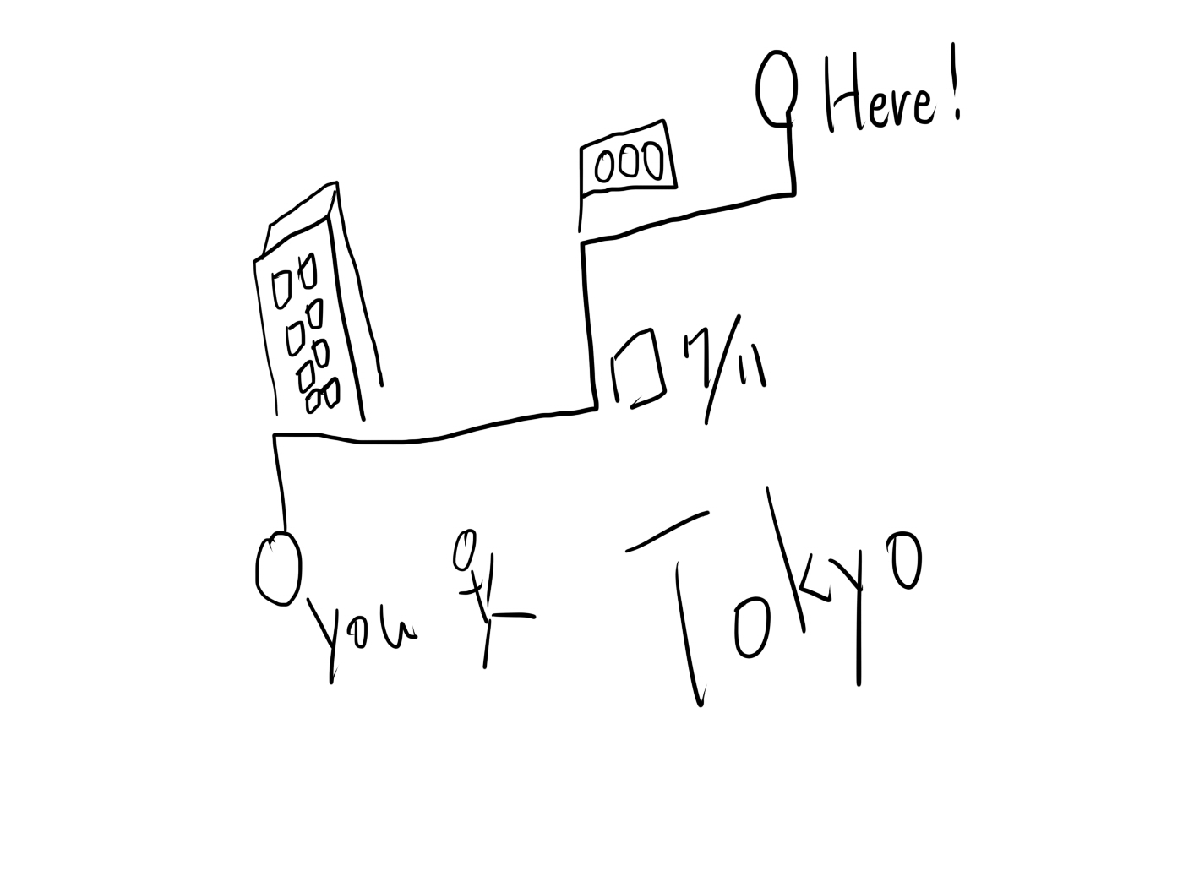


Slide 16
Model Selection
Comparing models
How do you compare your models
using in-sample data?

Slide 17
Model Selection
Task: Build a model to forecast car sales

Slide 18
Model Selection
Model selection isn’t easy!
Your decision process should dictate
your model selection process

